Slide 1


SQL CAPSTONE PROJECT On Education for All Fundraising
By: Adetutu Adejuyigbe
Data Analyst
March Cohort 2023

Slide 2
Introduction
The objectives of this project is to;
Determine the total number of donors in the database and devise strategies to increase the donor count.
Analyse the pattern of donation frequency and identify methods to enhance donor engagement.
Explore opportunities to increase the value of donations received.

Slide 3
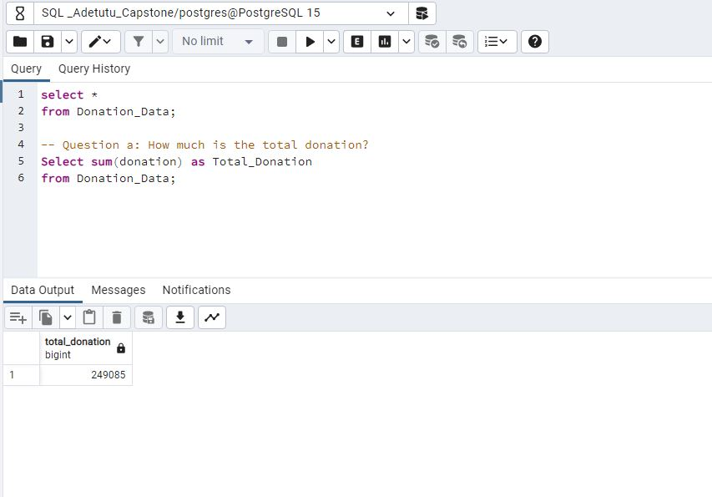
A: The total donation amount is $249,085 as displayed below.

Slide 4
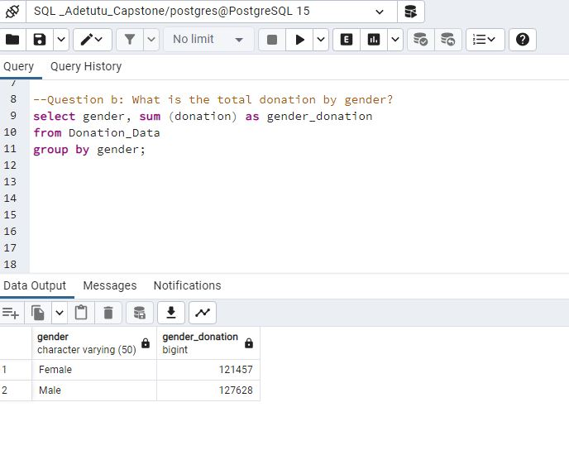
B: The data displays a total donation of $121,457 by the female gender and $127,628 by the male gender.

Slide 5
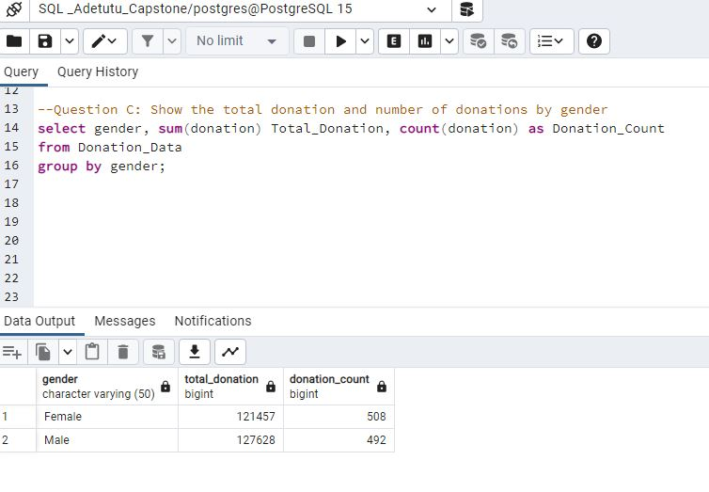
C:The displayed data reveals that the female gender has made a greater number of donations, totalling 508, with a combined donation amount of $121,457. On the other hand, the male gender has contributed 492 donations, amounting to $127,628 in total. Consequently, although the female gender has a higher count of donations, the male gender has contributed a greater total amount.

Slide 6
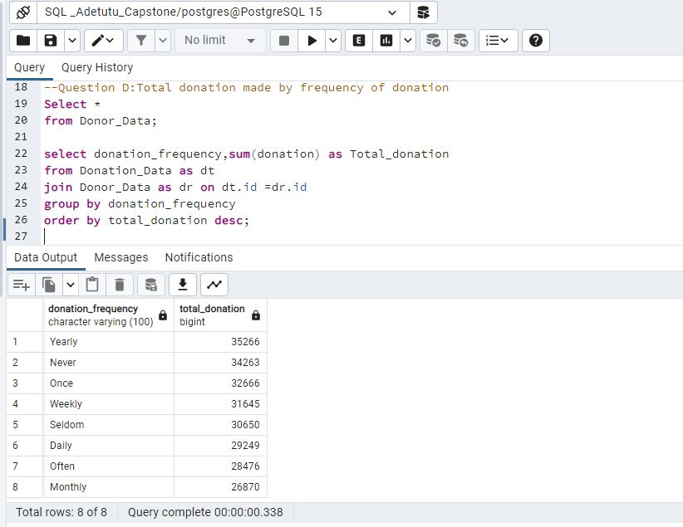
D: Among the 8 categories of donations classified by frequency, the category of "yearly frequency" takes the lead with a total donation of $35,266 which can be shown below.

Slide 7
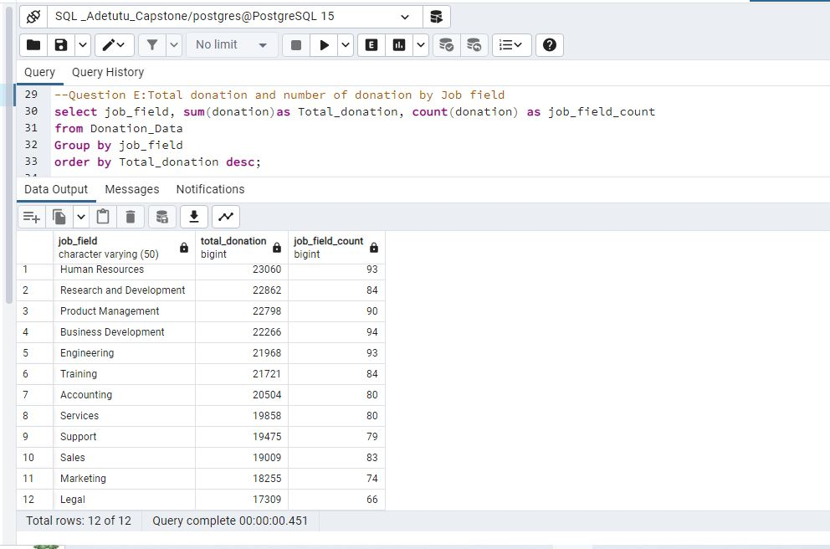
E: Among the 12 categories of donations based on job fields, human resources takes the lead with a total of 93 donations, amounting to $23,060 which can be seen below.

Slide 8
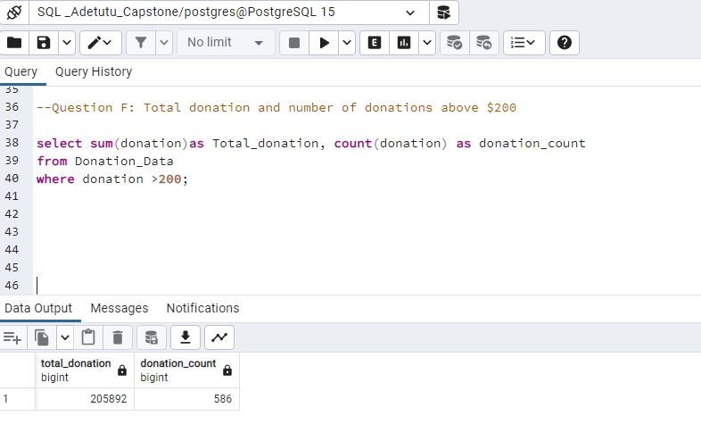
F: A total of 586 donations from donors are above $200, contributing a combined amount of $205,982.

Slide 9
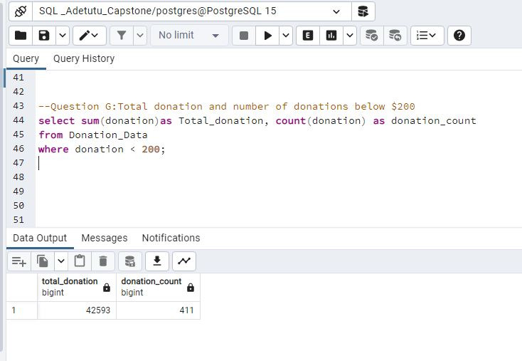
G: A total of 411 donations from donors fall below $200, contributing a combined amount of $42,593.

Slide 10
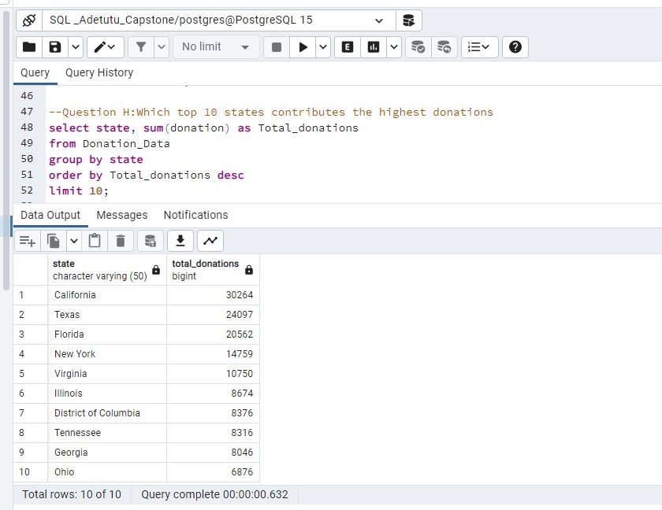
H: This data presents the top 10 states with the highest donation amounts. California ranks first on the list, with total donation of $30,264.

Slide 11
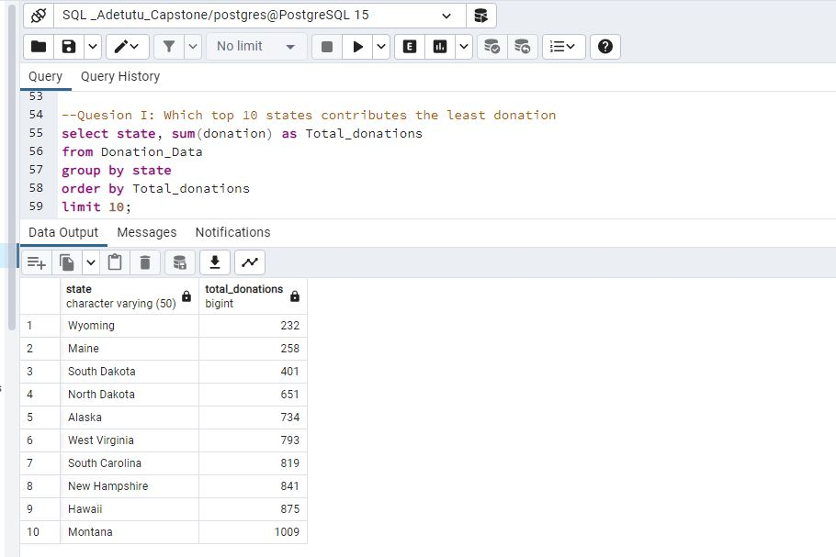
I: As displayed below, the top 10 states with the lowest donation amounts are listed below. Among them, Wyoming state stands out with the smallest donation, totalling $232.

Slide 12
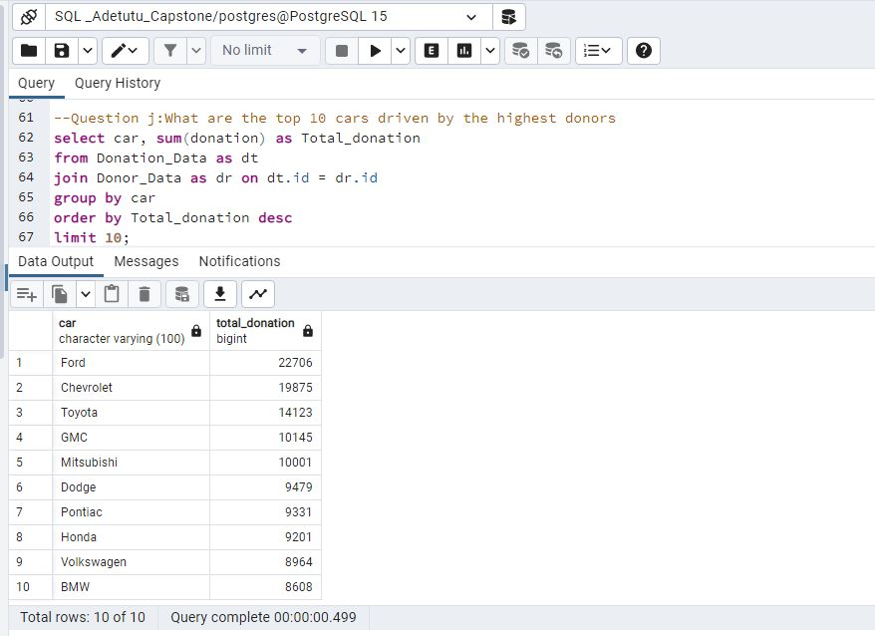
J:Below is a list of the top 10 cars driven by donors and Ford is the most prominent vehicle brand among the donors with a total donation of $22,706.

Slide 13
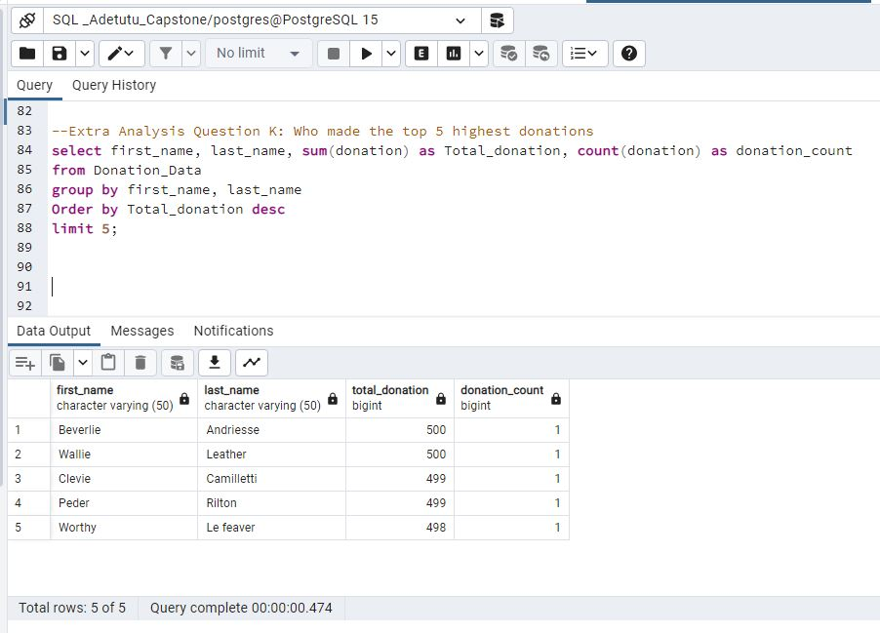
K: Below is a list of the top 5 donors ranked by their highest donations, with Beverile Andriesse appearing at the top of the donor list.

Slide 14
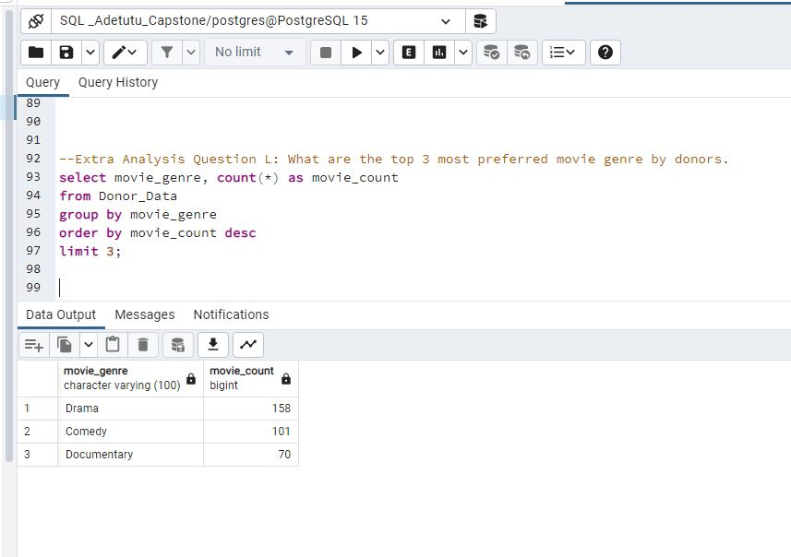
L: According to my analysis, Drama emerges as the top movie genre among donors, with total of 158 count.

Slide 15
Summary and Recommendations
Based on the generated insights, it is recommended to focus on optimizing donor acquisition, engagement, and contribution levels. By implementing the following strategies, the organization can strengthen its fundraising efforts;
Targeted Marketing Campaigns: Utilize social media and digital advertising to attract new donors and reach a wider audience.
Enhanced Donor Engagement: Foster stronger connections with donors through personalized communication strategies. Create opportunities for donor involvement, such as fundraising events tailored to their favourite movie genres.
Recurring Donations and Matching Gift Programs: Offer options for recurring donations and implement matching gift programs to incentivize higher-value contributions.
By implementing these recommended strategies, the organization can expand its donor base, improve donor engagement, and ultimately increase the overall value of donations received.

Slide 16

Thank You!

